Slide 1
Part 3: Web Mining

Slide 2
3.1 Document Classification

Slide 3
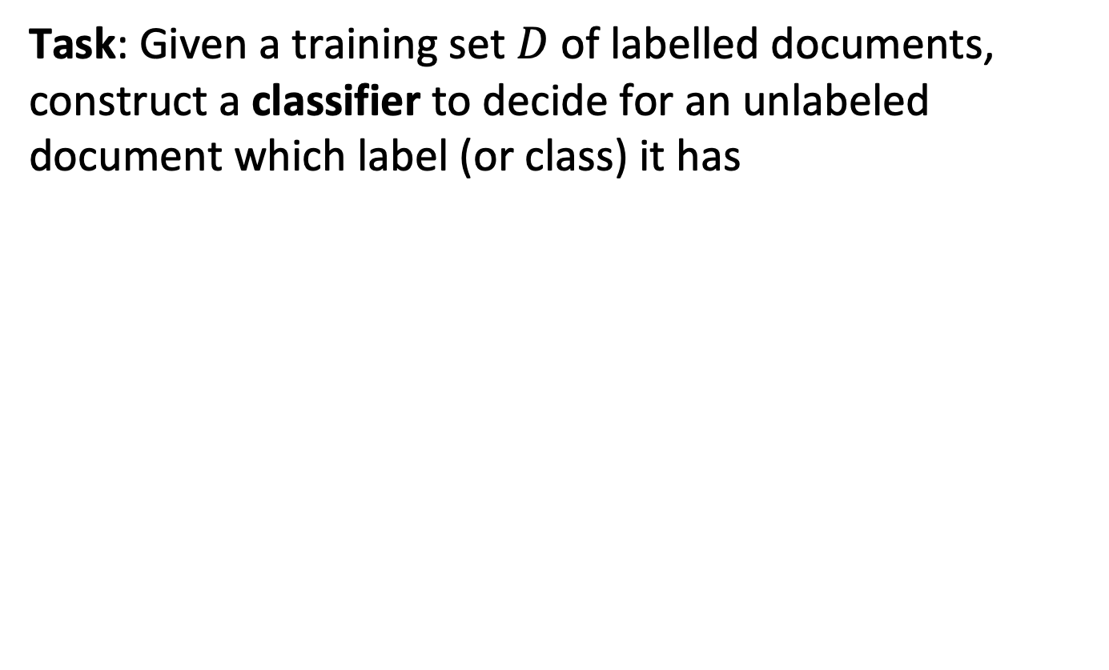
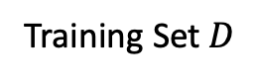
Document Classification
Task: Given a training set $D$ of labelled documents, construct a classifier to decide for an unlabeled document which label (or class) it has
?
New Document
Training Set $D$
Notes:
Document classification is the task to assign a class label to documents from an existing finite set of available labels. It is a task of huge practical importance in the management od documents. Information retrieval can be understood as one example of document classification, where the task is to distinguish relevant from non-relevant documents. But there are many other use cases, such as spam filtering, sentiment analysis, topic detection.

Slide 4
Document Classifiers
Features
Words of the documents
bag of words
document vector
More detailed information on words
Phrases
Word fragments (subwords, character n-grams))
Grammatical features
Any metadata known about the document and its author
Notes:
As for any classification problem, a central question is the choice of features used for classification. Like in information retrieval, the word features, which we called the full text, is an obvious choice. We can identify nevertheless many other features that can be exploited. Related to the text more detailed information about the words, including their grammatical features, can be used. Also, metadata on the documents, like the authorship or the history of usage during editing and reading can be considered.

Slide 5
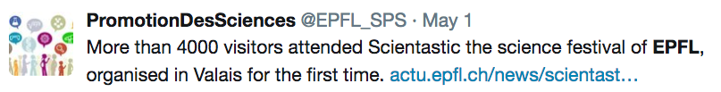
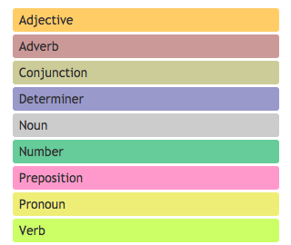
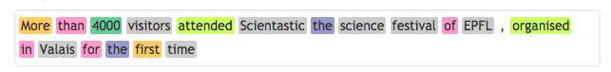
Example
Bag of words: {more, than, visitors, attend, …}
Phrases: {“science festival”, “first time”}
Word fragments: {mor, ore, tha, han, vis, isi, ..}
Grammatical features:
Author: @EPFL_SPS
http://parts-of-speech.info/
Notes:
Here we give a few examples of features that could be extracted from a simple tweet.

Slide 6
Challenge in Document Classification
The feature space is of very high dimension
Vocabulary size
All word bigrams
All character trigrams
etc.
Dealing with high dimensionality
Feature selection, e.g., mutual information
Dimensionality reduction, e.g., word embedding
Classification algorithms that scale well
Notes:
Document classification is a special case of classification, a problem widely studied in machine learning. What makes the problem specific, is the very large feature space that can be generated from documents, e.g., large vocabulary sizes.
In order to address the issue of large feature spaces, in machine learning different approaches are pursued.
Feature selection is used to identify among the available features those that have the largest distinctive power on deciding the class label. Many approaches, such as mutual information, are available from standard machine learning.
Dimensionality reduction is an approach that we have already introduced in the context of information retrieval, both with LSI and word embeddings.
Finally, having large number of features, suggest to also prefer classification algorithms that scale well with large numbers of features.

Slide 7
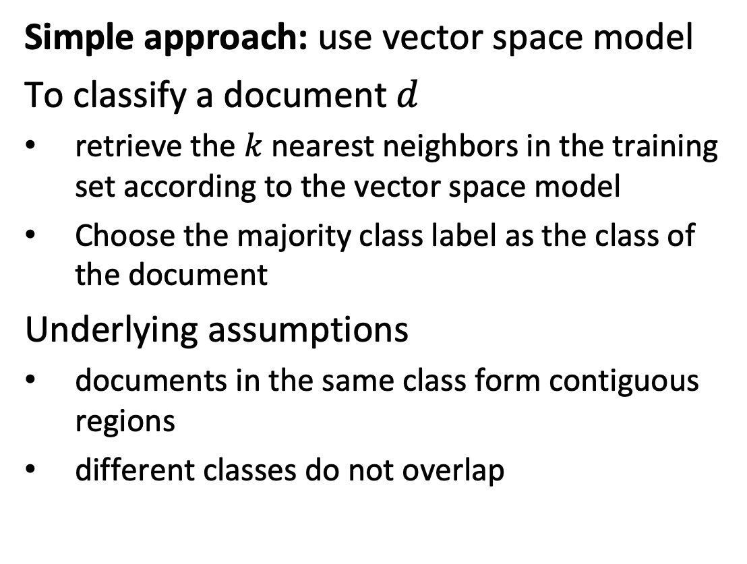
3.1.1 k-Nearest-Neighbors (kNN)
Simple approach: use vector space model
To classify a document $d$
retrieve the $k$ nearest neighbors in the training set according to the vector space model
Choose the majority class label as the class of the document
Underlying assumptions
documents in the same class form contiguous regions
different classes do not overlap
Notes:
A standard method for document classification is rooted in ideas we have already introduced for information retrieval. It is assumed that there exists a training set of labelled documents. In the kNN approach, the top k labelled documents that are most similar to the document to be classified are retrieved. The predicted class label is then chosen to be the one that has the majority among the retrieved documents. Ideally, k is chosen to be odd to break ties. The parameter k can also be determined using standard approaches of parameter tuning with a validation sets.
kNN relies on the implicit assumption that documents in the same class form contiguous regions, i.e., are close to each other, and that the regions of documents from different classes are not overlapping.
From the perspective of computational complexity, kNN exhibits the following properties:
Training requires to compute vector representations of documents. In the case of using tf-idf weights this implies tokenization of documents and computing the idf statistics for the document collection.
Inferring the class label requires the search for the closest k neighbors. Using simple scanning of the training set, the cost of inference grows linearly in the size of the training set, and therefore can be expensive.

Slide 8
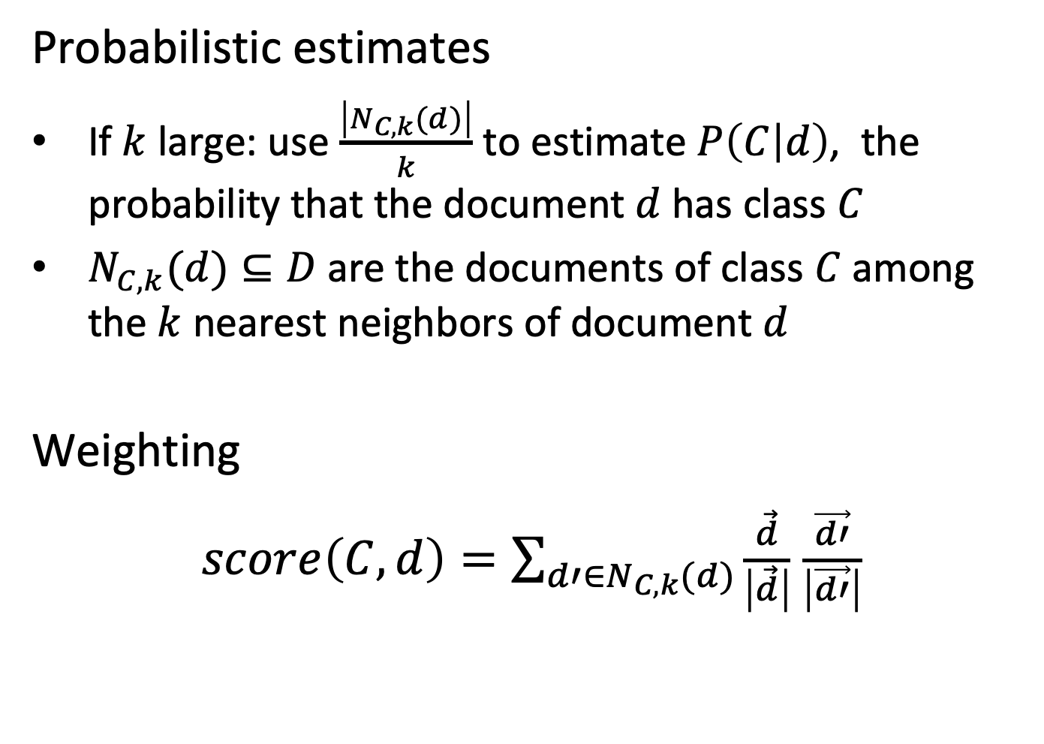
Variations of kNN
Probabilistic estimates
If $k$ large: use $\frac{\left|N_{C,k}(d)\right|}{k}$ to estimate $P\left(C | d\right)$, the probability that the document $d$has class $C$
$N_{C,k}(d)⊆D$ are the documents of class $C$ among the $k$ nearest neighbors of document $d$
Weighting
$score\left(C,d\right)=\sum_{d′∈N_{C,k}(d)}{\frac{\vec{d}}{\left|\vec{d}\right|}}$ $\frac{\vec{d′}}{\left|\vec{d′}\right|}$
Notes:
Two variations of kNN can be used. With probabilistic estimates not a class label is returned, but a probability distribution of the class labels. This is meaningful as k grows larger. With weighting the neighboring documents of a class contribute according to their distance to the document to be labelled. Therefore, documents that are more remote have less influence on the decision of the label. In general, this method is more accurate than the basic method.

Slide 9
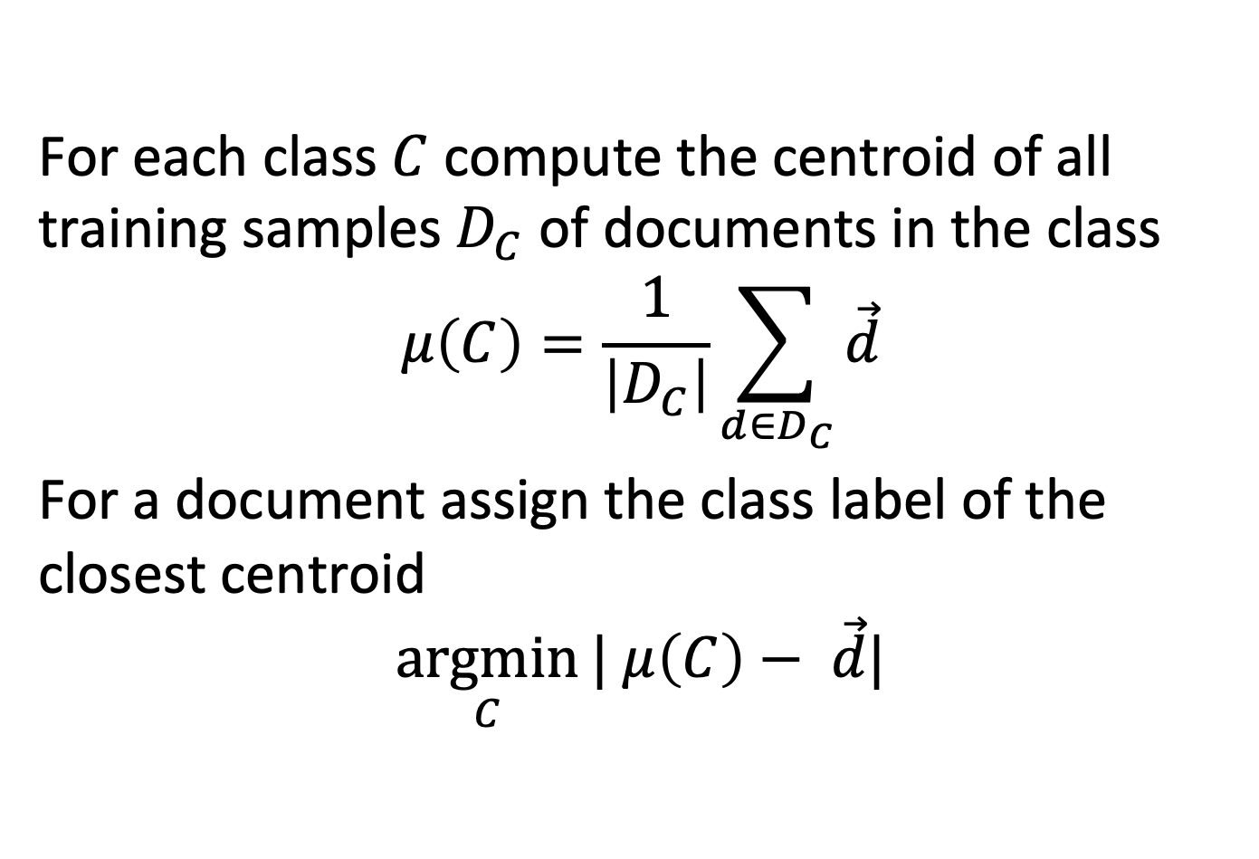
Rocchio classification
For each class $C$compute the centroid of all training samples $D_{C}$ of documents in the class
$$μ\left(C\right)=\frac{1}{\left|D_{C}\right|}\sum_{d∈D_{C}}{\vec{d}}$$
For a document assign the class label of the closest centroid
$$\underset{C}{argmin}{| μ\left(C\right)− \vec{d}|}$$
Notes:
An alternative model using the vector representation of documents for classification is the so-called Rocchio classification. As the name suggests, it exploits the same ideas that are used for user relevance feedback with the Rocchio method. For each class label, the centroids of the document vectors o the documents in the training set are computed. These centroids are then used to decide the class label of document by selecting the closest centroid. This method assumes that classes are not only continguous in the vector space, but also convex. This assumption is many practical cases not valid.

Slide 10
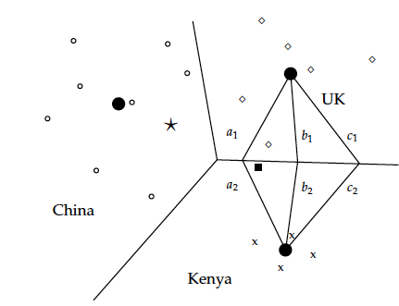
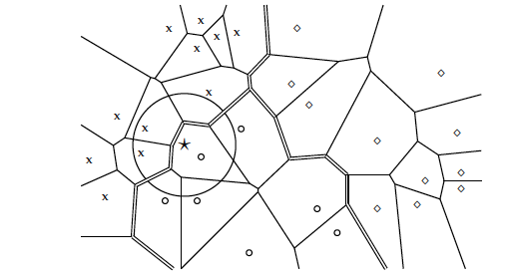
Linear vs. Non-linear Classification
Rocchio: linear
high bias
low variance
1NN: non-linear
low bias
high variance
Notes:
One of the most important questions in machine learning is the tradeoff among bias and variance. In short, bias essentially captures whether a model makes systematic mistakes independent of the training set used. High bias is in general associated with an incapacity of the model to capture essential aspects of the domain, which again results from too simple models. Variance captures the stability of the model under different training sets. High variance in general is associated with a too large capacity of the model to capture non-essential aspects of the domain, i.e. noise, a property that is called over-fitting. Rocchio and kNN provide a nice illustration of this trade-off. Rocchio is a linear model and as such not capable to capture non-linear decision boundaries among classes as illustrated on the left. Therefore for highly convoluted class boundaries the model will always have a large error. On the other hand, kNN is non-linear and can perfectly adapt to the nonlinear decision boundaries in the training data, when using k=1. However, this also means the model represents noise and outliers in the training data, and is prone to very instable predictions as the training data changes. kNN can be understood as a way to moderate the effect by “smoothing” the prediction boundaries over larger regions.

Slide 11
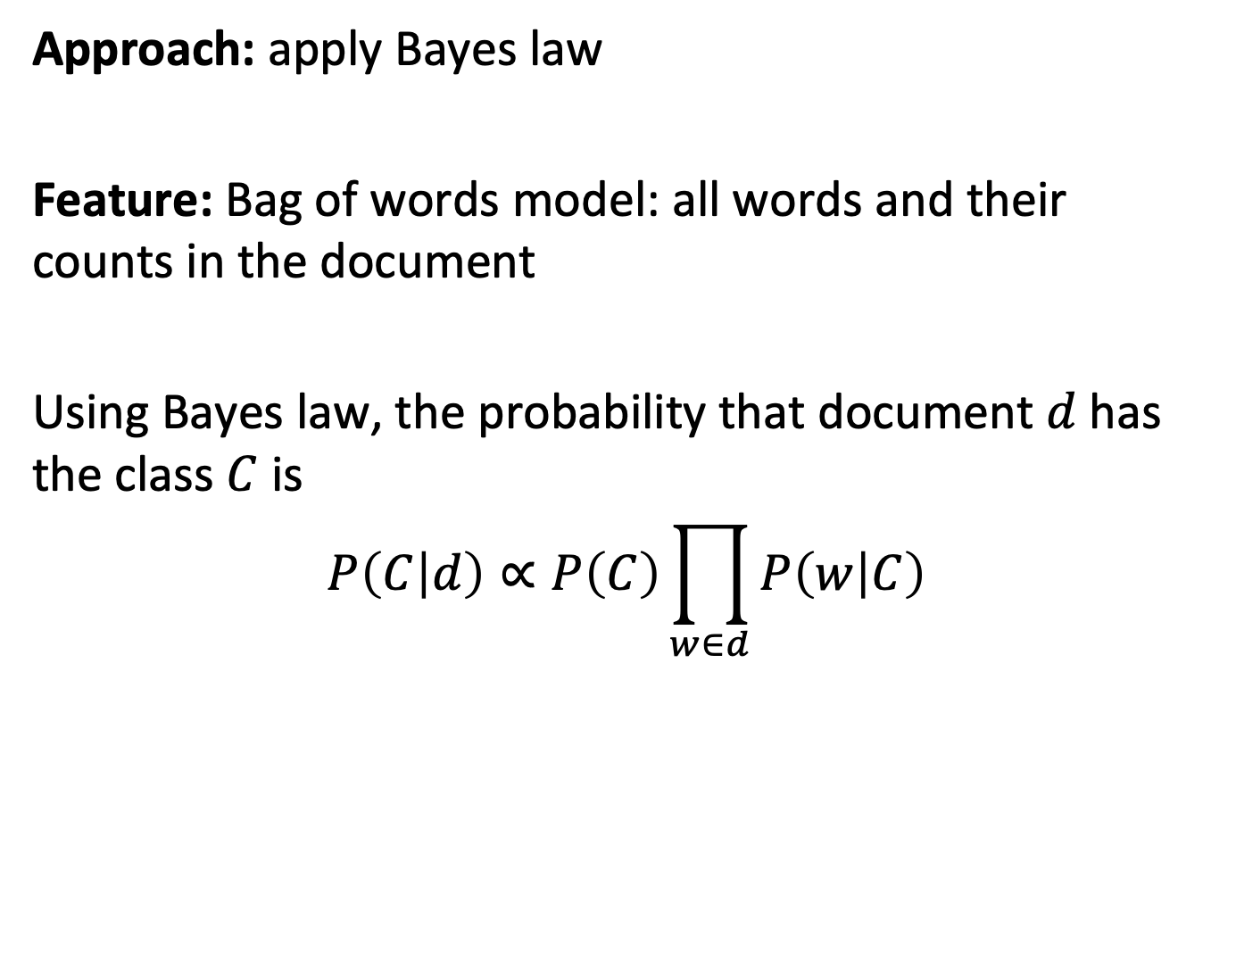
3.1.2 Naïve Bayes Classifier
Approach: apply Bayes law
Feature: Bag of words model: all words and their counts in the document
Using Bayes law, the probability that document $d$has the class $C$ is
$$P\left(C | d\right)∝P\left(C\right)\prod_{w∈d}{P\left(w | C\right)}$$
Notes:
Another frequently used method used in document classification is Naïve Bayes Classifier. Like kNN can be understood as the analogue of classification for vector space retrieval, Naïve Bayes can be understood as the analogue of classification for probabilistic retrieval. By applying Bayes law and making as in probabilistic retrieval an independence assumptions on the occurrence of words in documents, we can derive the probability of a document belonging to a class. The probabilities $P\left(C\right)$ and $P\left(w | C\right)$ are then derived from the available training data.
One problem in this formulation of the probability $P\left(C | D\right)$ is that for words that do not occur together with the class label in the training set, the probability of a document containing this word to have the class label becomes zero. This is an analogue problem we stated for the basic form of probabilistic retrieval, where documents not containing all query words would never be retrieved.

Slide 12
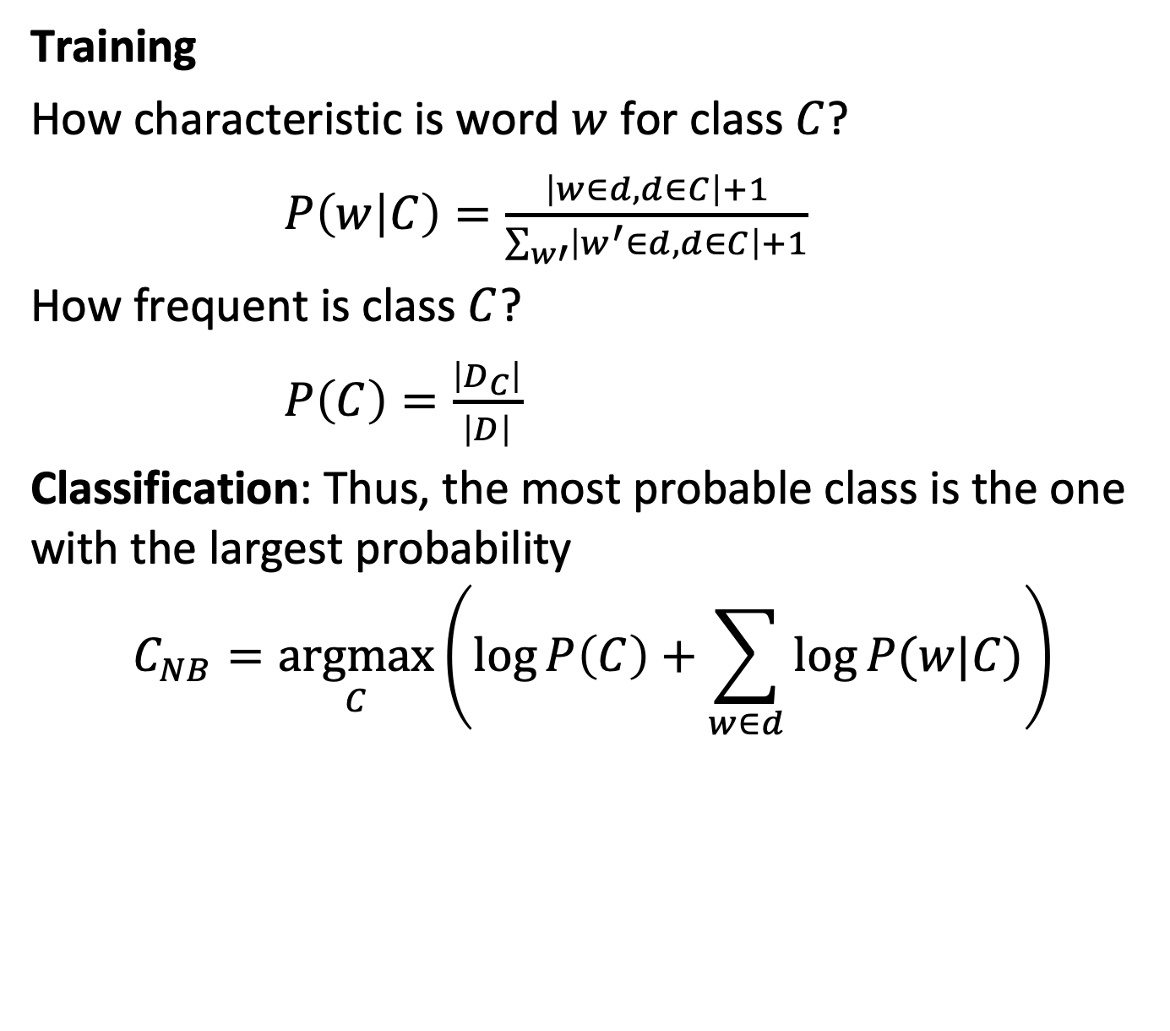
Naïve Bayes Classifier Method
Training
How characteristic is word $w$ for class $C$?
$P\left(w | C\right)=\frac{\left|w∈d,d∈C\right|+1}{\sum_{w′}{\left|w^{′}∈d,d∈C\right|}+1}$
How frequent is class $C$?
$P\left(C\right)=\frac{\left|D_{C}\right|}{\left|D\right|}$
Classification: Thus, the most probable class is the one with the largest probability
$$C_{NB}=\underset{C}{argmax}\left(\log{P\left(C\right)+\sum_{w∈d}{\log{P(w|C)}}}\right)$$
Laplacian smoothing
Notes:
For training a Naïve Bayes model we have to estimate the probabilities $P\left(w | C\right)$ and $P\left(C\right)$. $P\left(C\right)$ is straightforward to compute it is simply the probability of each class label to occur in the training set. For the probability $P\left(w | C\right)$ we apply Laplacian smoothing to avoid the problem of words not occurring for a class in the training set. Then the probability is estimated as the likelihood of word occurring in the documents of the class as compared to the overall number of occurrences of the word.
Classification is performed by selecting the class with the highest probability to occur. This is computed by applying the logarithm to the estimated probability, as the summation is numerically more stable than multiplication.

Slide 13
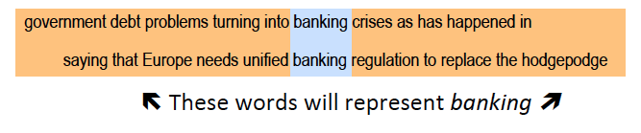
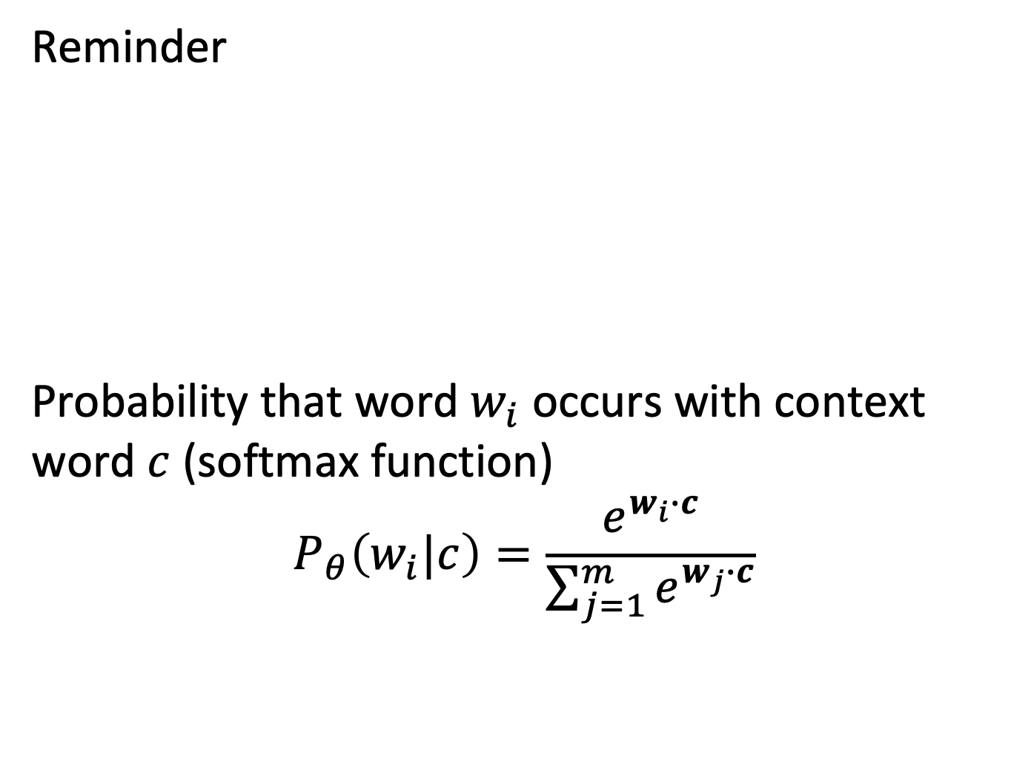
3.1.3 Classification Using Word Embeddings
Reminder
Probability that word $w_{i}$ occurs with context word $c$ (softmax function)
$$P_{θ}\left(w_{i}|c\right)=\frac{e^{w_{i}∙c}}{\sum_{j=1}^{m}{e^{w_{j}∙c}}}$$
Notes:
Word embeddings provide a representation of documents that can not only be used for information retrieval, but also for document classification. They provide a low-dimensional feature vector that can be used for performing classification with supervised learning. We will now introduce one recent approach that has been proposed with the Fasttext approach. In fact, the initial application of FastText was document classification.

Slide 14
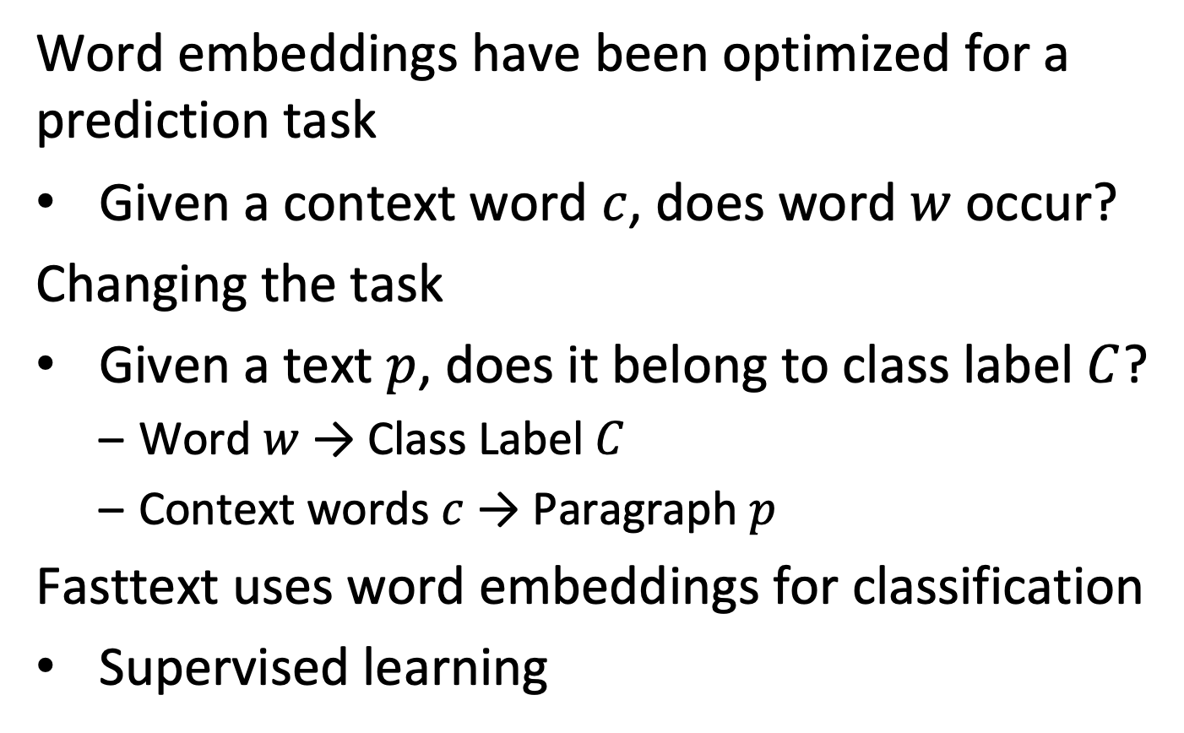
Classification Task
Word embeddings have been optimized for a prediction task
Given a context word $c$, does word $w$ occur?
Changing the task
Given a text $p$, does it belong to class label $C$?
Word $w$ → Class Label $C$
Context words $c$ → Paragraph $p$
Fasttext uses word embeddings for classification
Supervised learning
Notes:
Document classification is a task that is different from the task considered for constructing word embeddings in an unsupervised approach, as we have introduced it earlier. The task we had considered consisted of predicting the co-occurrence of words and context words. For document classification we have a training data set of labelled documents. Using that training data, we can modify the task as follows: instead of predicting for a given context word the corresponding word (or vice versa), we predict for a piece of text, a paragraph, the related class label. Therefore, the role of the context word will be taken over by the paragraph for which the label is predicted, and the prediction is on the class label and not on the center word.

Slide 15
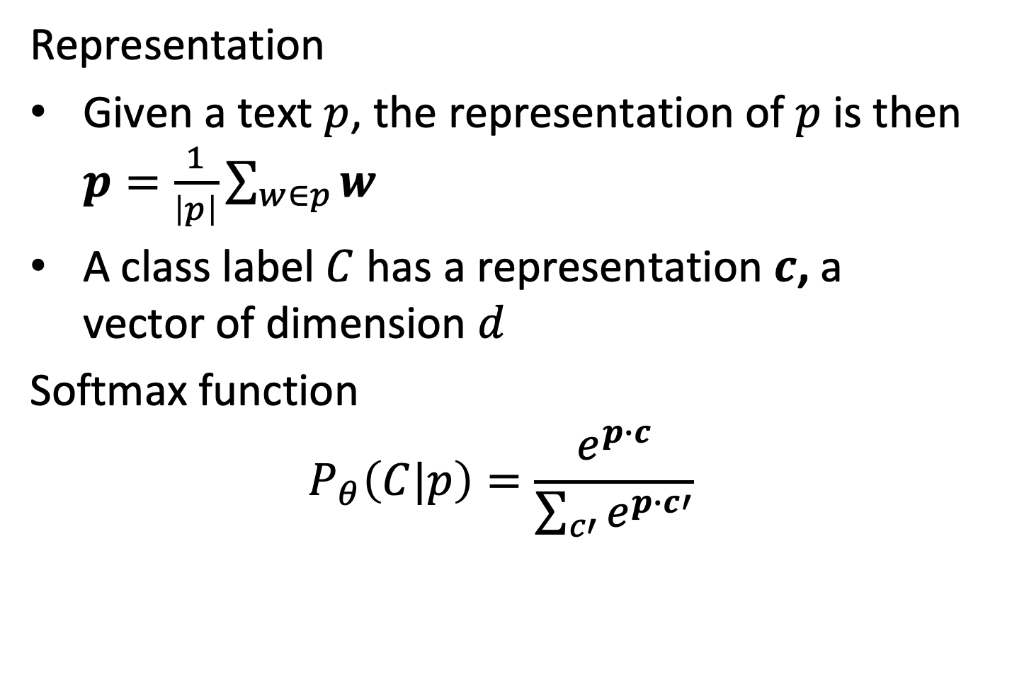
Adapting the Model for Classification
Representation
Given a text $p$, the representation of $p$ is then $p=\frac{1}{\left|p\right|}\sum_{w∈p}{w}$
A class label $C$ has a representation $c$, a vector of dimension $d$
Softmax function
$$P_{θ}\left(C|p\right)=\frac{e^{p∙c}}{\sum_{c′}{e^{p∙c′}}}$$
Notes:
Since the prediction is performed not for single words, but for texts, the text from paragraphs is aggregated by computing the average word embedding vector of all words in the paragraph. For each class label also a d-dimensional vector is generated. The predicted probability of a class label occurring with a paragraph is then computed using the softmax function. Note that different to the use of the softmax function for the word prediction task, the number of class labels is usually small, so that the computation of the softmax function does not create signficant computational cost.

Slide 16
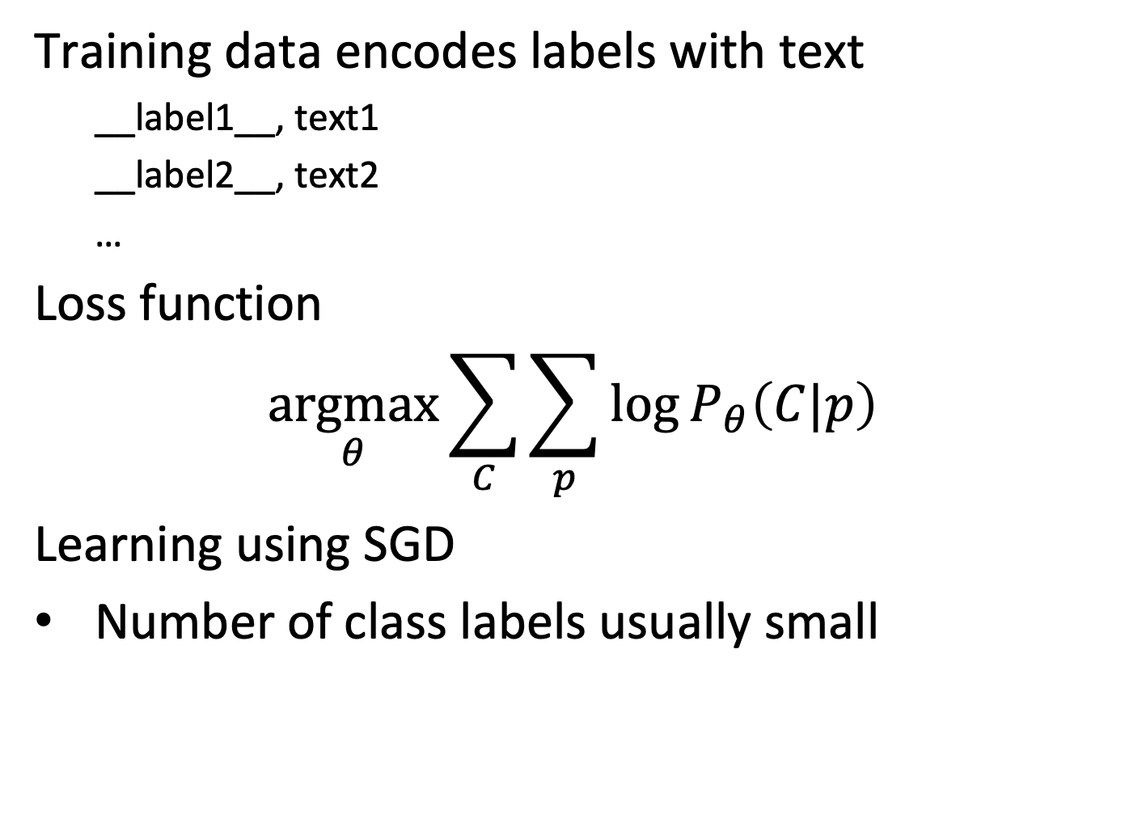
Implementation of the Model
Training data encodes labels with text
__label1__, text1
__label2__, text2
…
Loss function
$$\underset{θ}{argmax}\sum_{C}{\sum_{p}{\log{P_{θ}\left(C|p\right)}}}$$
Learning using SGD
Number of class labels usually small
Notes:
For the implementation of the model the training data is presented as pairs of labels and text paragraphs. The simplest loss function is maximizing the logarithm of the joint probabilites of all class label-paragraph pairs. Learning can be performed using standard stochastic gradient descent. In practice, different variants of this model are implemented, e.g., using alternative loss functions.

Slide 17
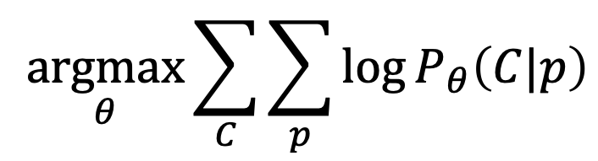
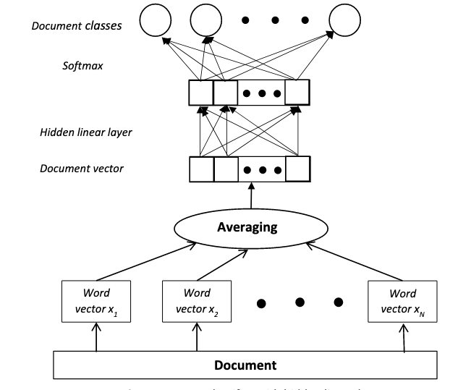
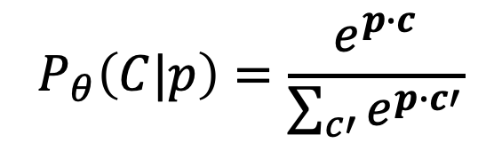
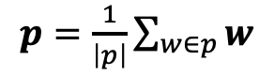
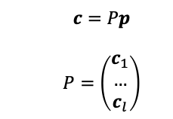
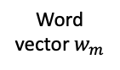
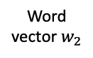
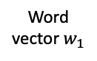

Summary of the Classification Model
$$c=Pp$$
$$P=\left(\begin{matrix}c_{1} \\ … \\ c_{l}\end{matrix}\right)$$
Word vector $w_{1}$
Word vector $w_{2}$
Word vector $w_{m}$
$$w=W^{(w)}w$$
Paragraphs
Notes:
This figure summarizes the different steps of the fasttext classification model. Note that the encoding of the class labels into d-dimensional vectors can be representated by a matrix P, with the vectors for each of the l class labels as rows. The graphical representation used in this figure is a common way to describe a model used for learning. One can understand it to depict graphically the composition of a complex function.
Figure: Analysis and Optimization of fastText Linear Text Classifier, Vladimir Zolotov and David Kung, https://arxiv.org/abs/1702.05531

Slide 18
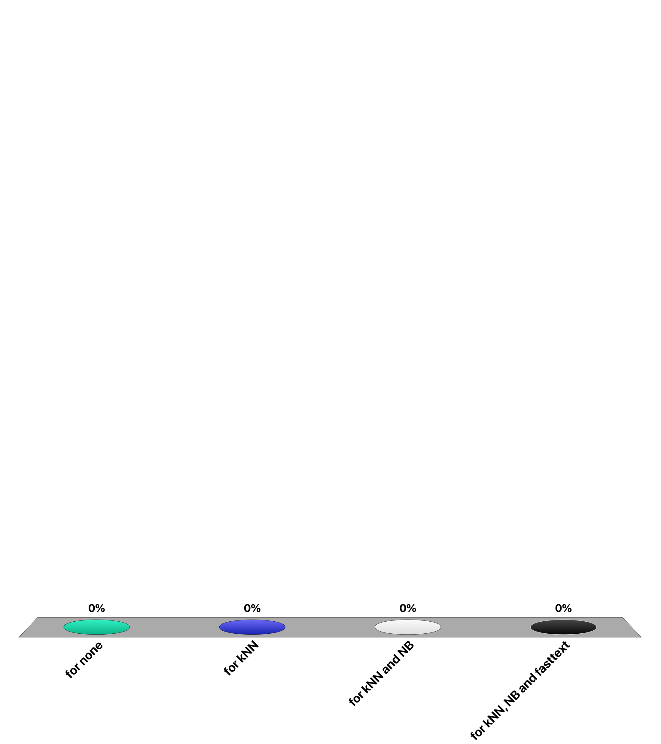
For which document classifier the training cost is low and inference is expensive?
for none
for kNN
for NB
for fasttext

Slide 19
How many among the listed classifiers can be used to derive probability estimate of the class label?
1NN, kNN, Rocchio, NB, fasttext
1
2
3
4

Slide 20
3.1.4 Transformer Models
A new architecture for machine learning models
Initially conceived for machine translation
Extending standard neural network architectures (NN)
Uses basic NN and backpropagation (BP)
Detailed understanding of BP not needed, we have seen simple examples of BP earlier
Employed by well-known models, such as BERT, GPT
State-of-the-art results in many tasks in NLP, computer vision and speech
Based on self-attention
Notes:
Transformer models are a new type of models for creating text embedding, that have initially been developed for machine translation, and later been adapted for other tasks, such as document classification. They are based on an extension of neural networks, using a mechanism known as self-attention. Self-attention introduces into the model a way to capture contextual dependencies among words in a text, which has led to a significant improvement in the performance for many natural language processing tasks. One of the best-known models of this class is BERT.

Slide 21
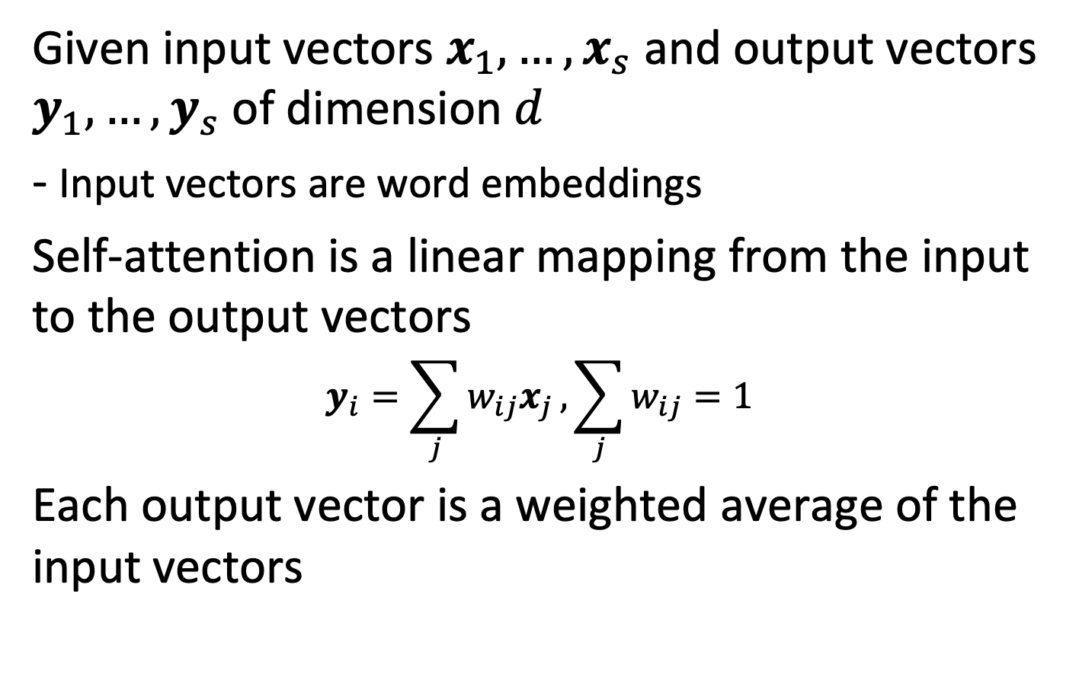
Self-attention
Given input vectors $x_{1},…,x_{s}$ and output vectors $y_{1},…,y_{s}$ of dimension $d$
- Input vectors are word embeddings
Self-attention is a linear mapping from the input to the output vectors $$y_{i}=\sum_{j}{w_{ij}x_{j}},\sum_{j}{w_{ij}=1}$$
Each output vector is a weighted average of the input vectors
Notes:
In its simplest form, the self-attention mechanism is very straightforward. It transforms a set of input vectors, e.g., representing the words of a sentence that are learnt like with word embeddings, to a set of output vectors of the same dimension. The self-attention mechanisms consists of a linear mapping from the input vectors to the output vectors. One can consider this mapping as computing weighted averages of the input vectors.
Note that in the following we will use a notation different from before, where we denote word vectors as $x_{1},…,x_{s}$ and not as $w_{1},…,w_{s}$. $s$ one can interpret as the length of a sentence consisting of words $w_{1},…,w_{s}$. We will consistently denote vectors in bold.

Slide 22
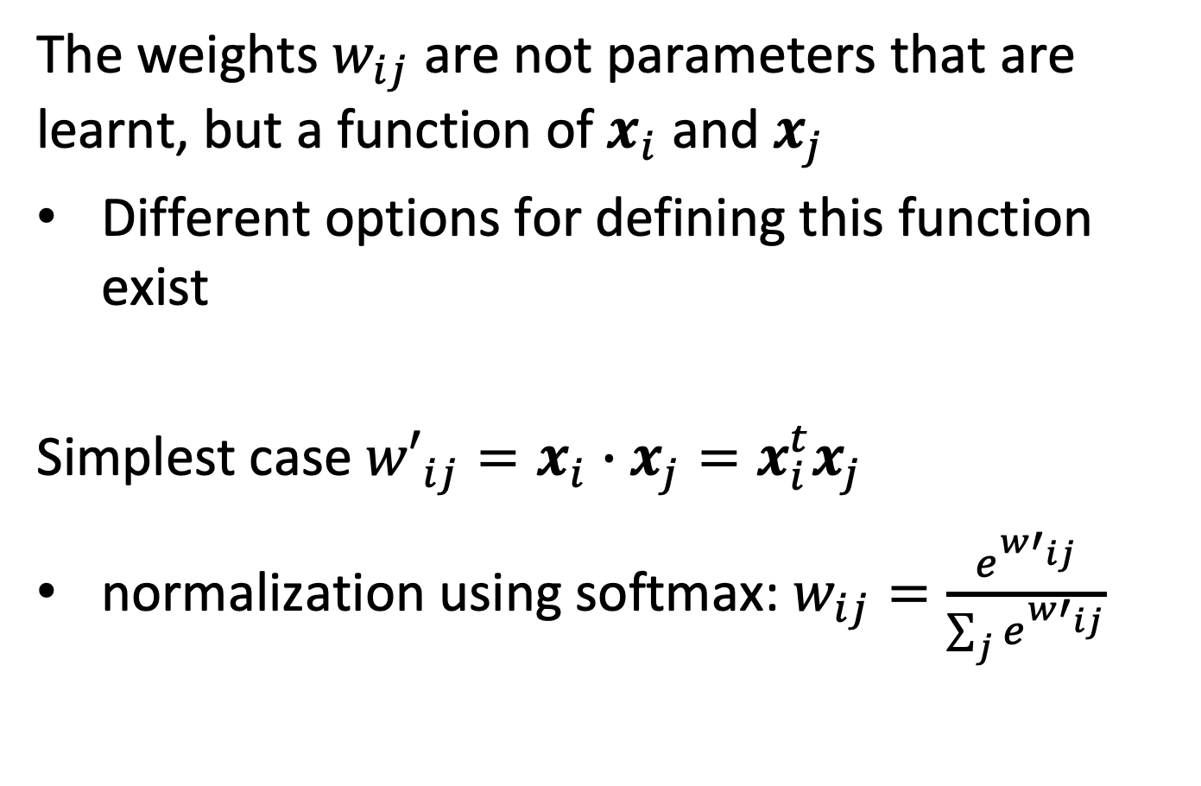
Self-attention Weights
The weights $w_{ij}$ are not parameters that are learnt, but a function of $x_{i}$ and $x_{j}$
Different options for defining this function exist
Simplest case ${w′}_{ij}=x_{i}∙x_{j}=x_{i}^{t}x_{j}$
normalization using softmax: $w_{ij}=\frac{e^{{w′}_{ij}}}{\sum_{j}{e^{{w′}_{ij}}}}$
Notes:
However, the weights used in the linear mapping are not some arbitrary parameters that are learnt from training data but depend themselves on the input vectors. In the simplest case, this dependency would be given as the scalar product of two input vectors $x_{i}$ and $x_{j}$ producing the weight $w_{ij}$, followed by the application of a softmax function, such that the weights add up to 1 for one dimension. This implies that while learning the vector representation of words, a dependency among the different vectors in a sequence of words is introduced.

Slide 23
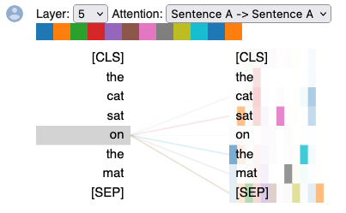
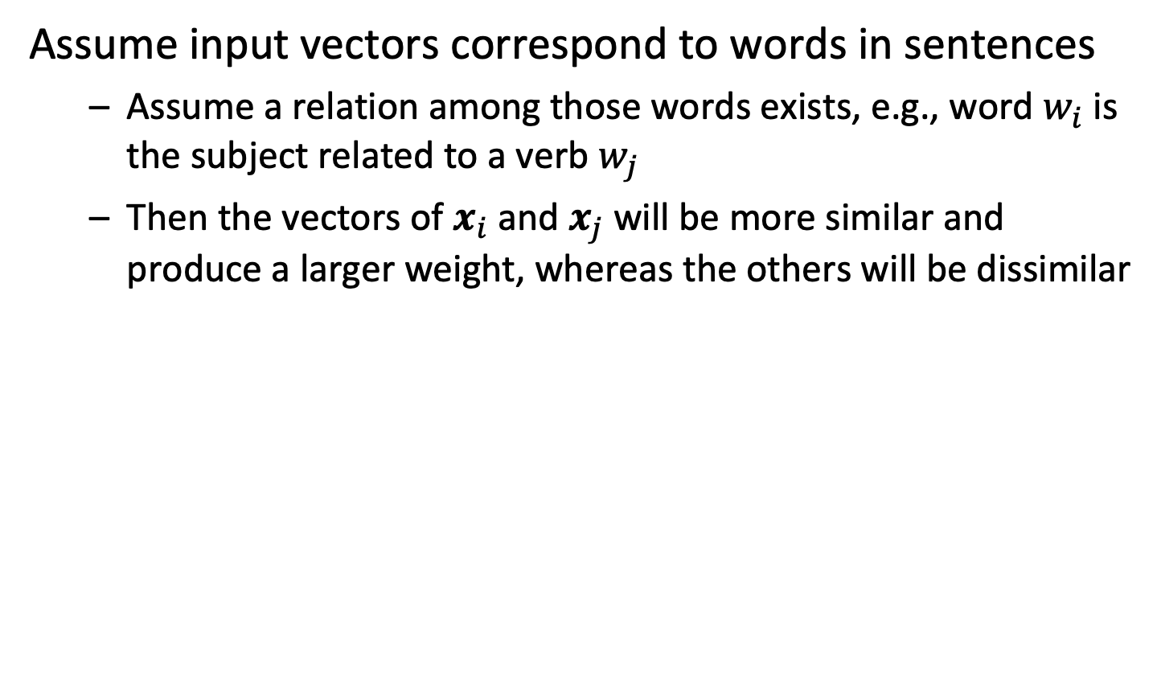
Intuition
Assume input vectors correspond to words in sentences
Assume a relation among those words exists, e.g., word $w_{i}$ is the subject related to a verb $w_{j}$
Then the vectors of $x_{i}$ and $x_{j}$ will be more similar and produce a larger weight, whereas the others will be dissimilar
Notes:
The self-attention mechanism is what enables to capture the contextual relationships among the words in a text. In the visualization the weights for one self-attention layer are shown. One can observe that the word “on” is most related to the words sat.
The visualization tool can be found on: https://github.com/jessevig/bertviz

Slide 24
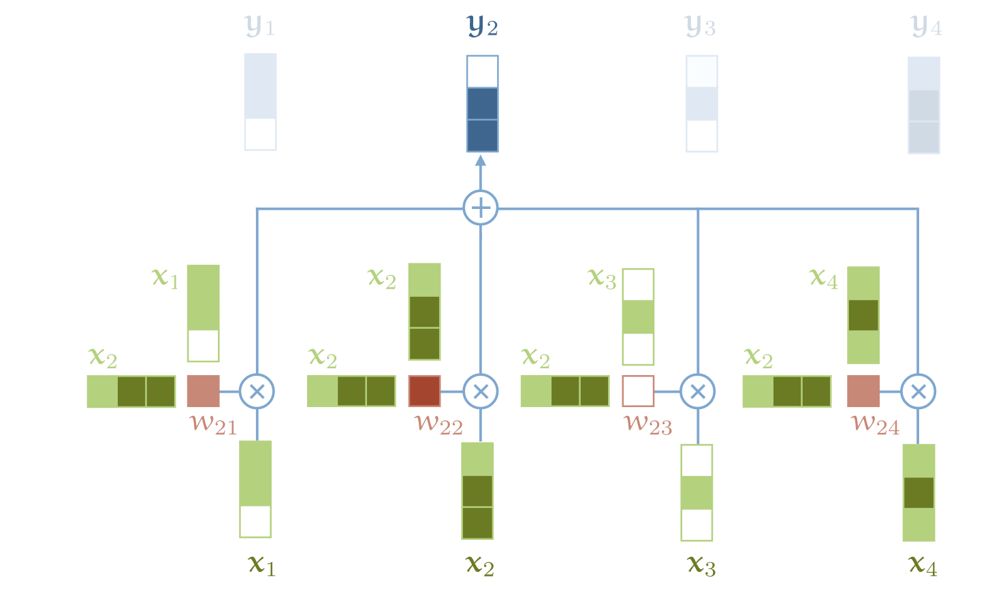
Illustration
The output vector at position $i$ are obtained by multiplying the input vector at position $j$
with weights $wij$ and adding up
Notes:
This figure graphically illustrates of how the output vectors are obtained from the input vectors. Note that the input vectors occur in three different ways, as input, as factor in the weight applied to itself, and as factor in the weight applied to another input vector.

Slide 25
Applied to Text
1. For each input token, create an embedding vector
Using embedding matrix as for word embeddings
2. Convert a sentence into a sequence of vectors
3. Learn the parameters of the embedding matrix by performing a task using the vectors generated by the self-attention mechanism
Notes:
When the self-attention mechanism is applied to text, the input vectors are word embeddings derived from the input token vectors (in 1-hot representation) using an embedding matrix, and a sentence is converted into a sequence of vectors. The sequence of vectors is then fed into the self-attention mechanism. The vectors resulting from the self-attention mechanism are then used to perform a task, i.e., are used to compute a loss function that is optimized by adapting the model parameters of the word embedding matrices using gradient descent.

Slide 26
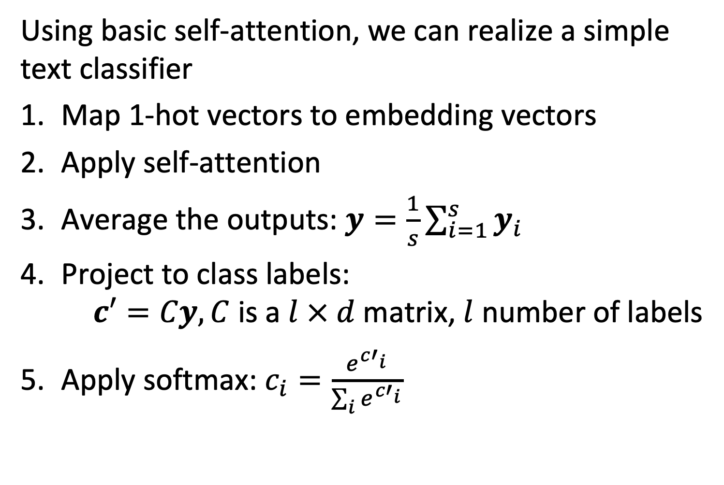
Simple Text Classifier
Using basic self-attention, we can realize a simple text classifier
Map 1-hot vectors to embedding vectors
Apply self-attention
Average the outputs: $y=\frac{1}{s}\sum_{i=1}^{s}{y_{i}}$
Project to class labels: $c′=Cy, C$ is a$l × d$matrix, $l$ number of labels
Apply softmax: $c_{i}=\frac{e^{{c′}_{i}}}{\sum_{i}{e^{{c′}_{i}}}}$
Notes:
With the basic self-attention mechanism described, it would be already possible to construct a basic text classifier. For this, the output vectors generated from the self-attention mechanism are averaged, and then projected to a vector that has the dimension $l$ of the label space (e.g. in case of binary classification to a vector of dimension 2). In order to interpret the outputs as probabilities, finally a softmax function is applied.

Slide 27
Question
The number of parameters of the fasttext classifier and the simple self-attention classifier
Are the same
Fasttext has more
Self-attention has more

Slide 28
Information Flow in Transformer
The self-attention mechanism is the only mechanism where different input vectors interact to produce the output vector
All other operations are applied to the input vectors in isolation
Notes:
The input vectors interact among each other using the self-attention mechanism. In this way relations among different words in a sentence are captured. All other operations applied to vectors in a transformer network are performed independently.

Slide 29
More “Tricks”
Standard transformer models introduce many additional features
Queries, keys, values
Scaling
Multiple heads
Residual connections
Layer normalization
Multilayer perceptrons
Position embedding
Notes:
We have shown how to construct a basic text classifier using a self-attention mechanism. In practice, many additional mechanisms are used to produce the transformer models used today in practice. The design of these mechanism is based on numerous theoretical and empirical insights gained in research. In the following we will introduce the main ideas, without being able to enter in all details.

Slide 30
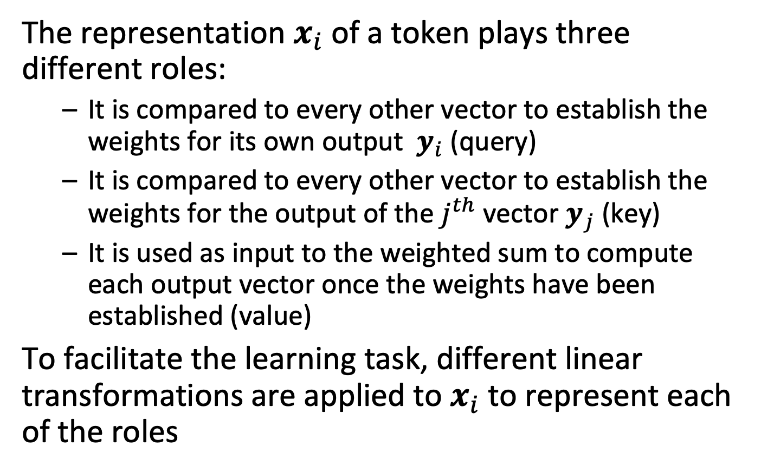
Queries, Keys, Values
The representation $x_{i}$ of a token plays three different roles:
It is compared to every other vector to establish the weights for its own output $y_{i}$ (query)
It is compared to every other vector to establish the weights for the output of the $j^{th}$ vector $y_{j}$ (key)
It is used as input to the weighted sum to compute each output vector once the weights have been established (value)
To facilitate the learning task, different linear transformations are applied to $x_{i}$ to represent each of the roles
Notes:
As observed for the basic self-attention mechanism, the input vectors play 3 different rules in the self-attention mechanism.
The better accommodate for these three roles, linear transformation are introduced that generate 3 different vectors for them, from the input vectors.
These linear transformations introduce additional parameters that have to be learnt.

Slide 31
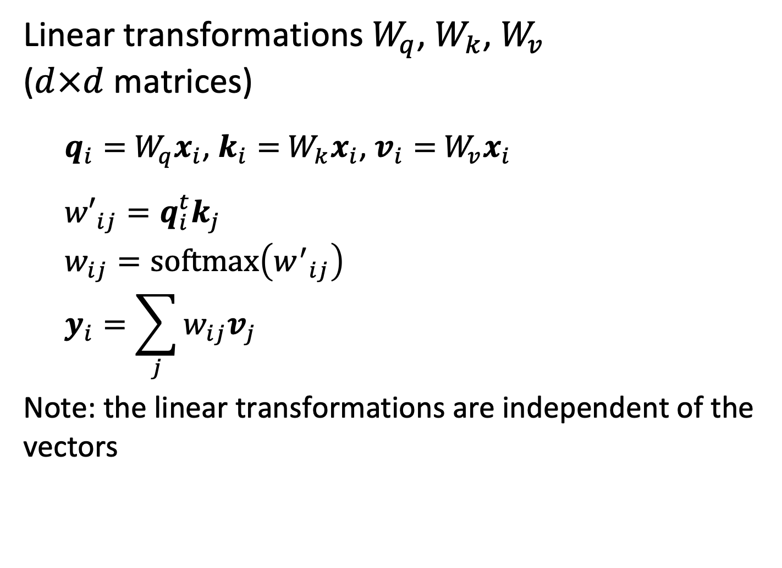
Queries, Keys, Values
Linear transformations $W_{q}$, $W_{k}$, $W_{v}$ ($d×d$ matrices)
$q_{i}=$ $W_{q}x_{i}$, $k_{i}=$ $W_{k}x_{i}$, $v_{i}=$ $W_{v}x_{i}$
$${w′}_{ij}=q_{i}^{t}k_{j}$$
$$w_{ij}=softmax\left({w^{′}}_{ij}\right) \\ y_{i}=\sum_{j}{w_{ij}v_{j}}$$
Note: the linear transformations are independent of the vectors
Notes:
The linear transformations for query, key and value are part of the parameters that will be learnt, but are independent of the input vectors, i.e., only 3 constant linear mappings are learnt for a self-attention mechanism.

Slide 32
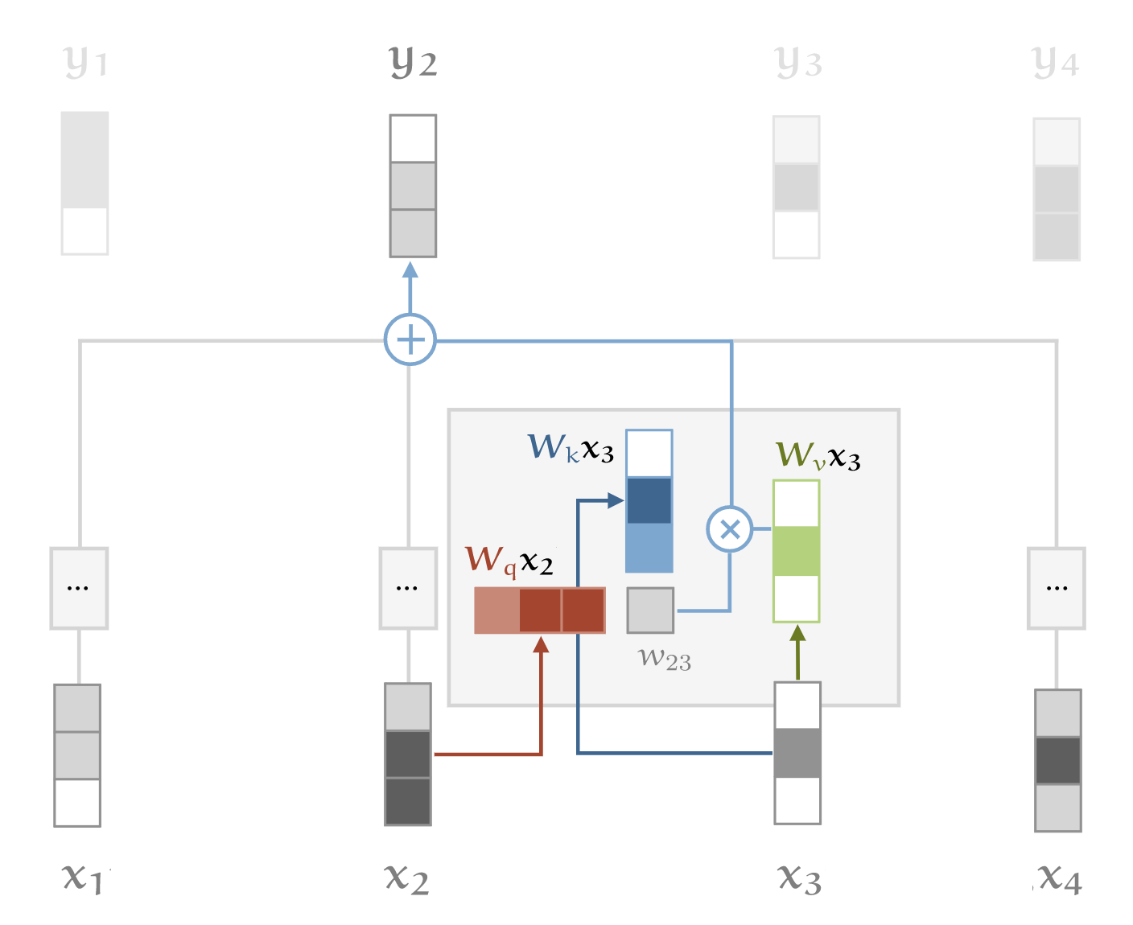
Illustration
Notes:
The figure illustrates of how the 3 linear mappings are applied to the input vectors before the self-attention mechanisms computes a weighted average of the inputs.

Slide 33
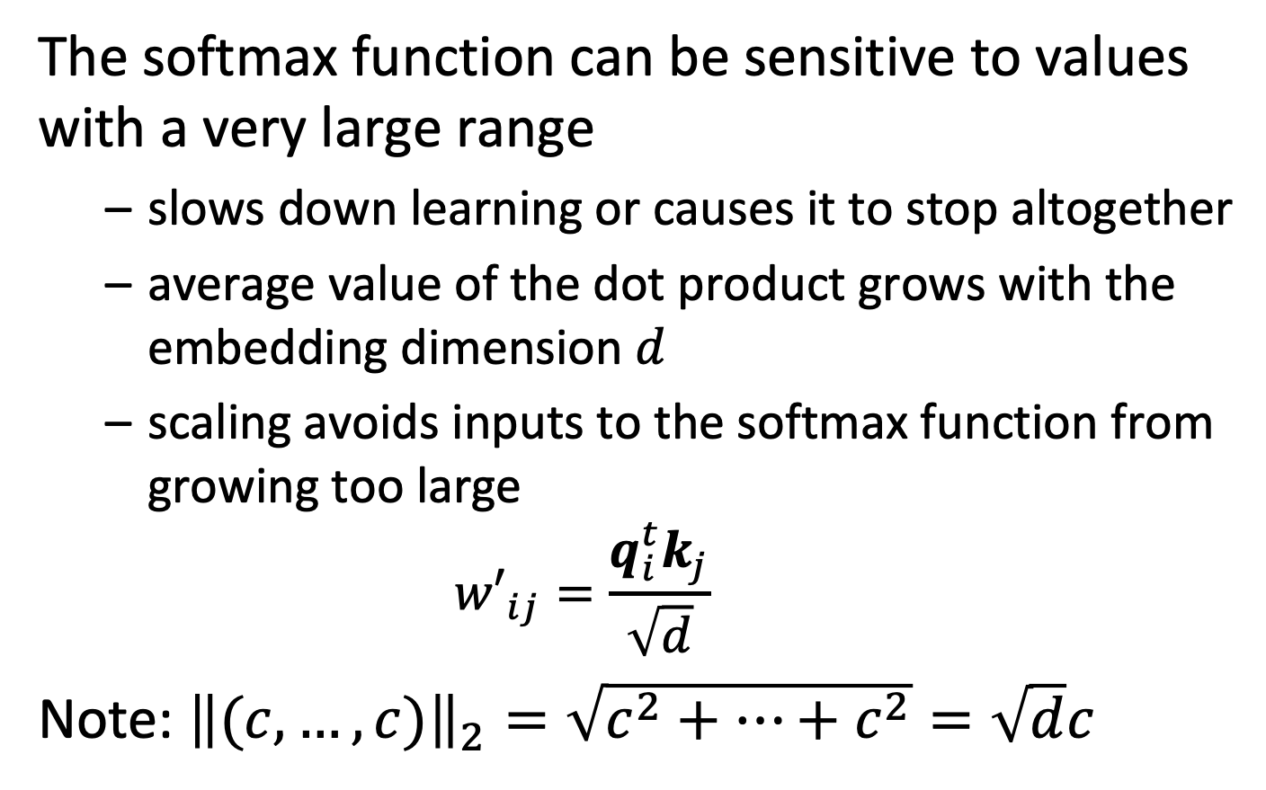
Scaling
The softmax function can be sensitive to values with a very large range
slows down learning or causes it to stop altogether
average value of the dot product grows with the embedding dimension $d$
scaling avoids inputs to the softmax function from growing too large ${w′}_{ij}=\frac{q_{i}^{t}k_{j}}{\sqrt{d}}$
Note: ${\left\|(c,…,c)\right\|}_{2}=\sqrt{c^{2}+…+c^{2}}=\sqrt{d}c$
Notes:
A second feature is scaling the vectors. This accounts for the fact that the softmax function becomes numerically unstable for values with a very large range. The problem is avoided by scaling the values, before feeding them into the softmax function. Scaling normalizes the output vectors to the same norm, independent of the dimension $d$ chosen for the embedding vectors.

Slide 34
Multi-head Attention
A word can mean different things to different neighboring words
Example
Mary gave roses to John
what
whom
3 different types of relationships
who
Mary gave roses to John
Notes:
In text multiple, different, relationships exist between different words. Capturing all these relationship in a single representation of the input word is difficult. Therefore, transformer networks employ multiple self-attention mechanisms in parallel, each of which can learn a different kind of relationship. This is called multi-head attention.

Slide 35
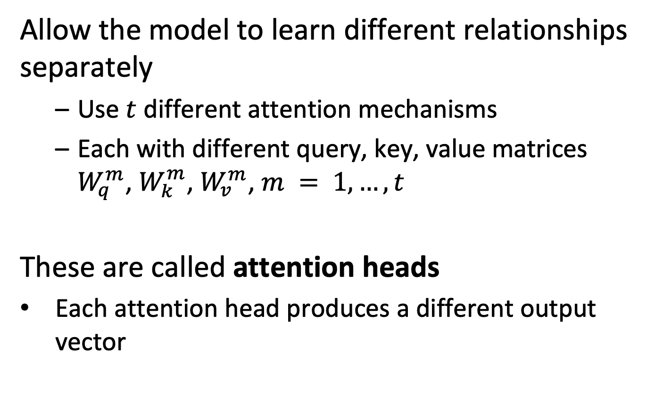
Multi-head Attention
Allow the model to learn different relationships separately
Use $t$ different attention mechanisms
Each with different query, key, value matrices $W_{q}^{m}$, $W_{k}^{m}$, $W_{v}^{m}$, $m = 1,…,t$
These are called attention heads
Each attention head produces a different output vector
Notes:
When using multi-head attention, different query, key and value matrices are learnt for each attention head, allowing to represent different types of syntactic and semantic relationships.

Slide 36
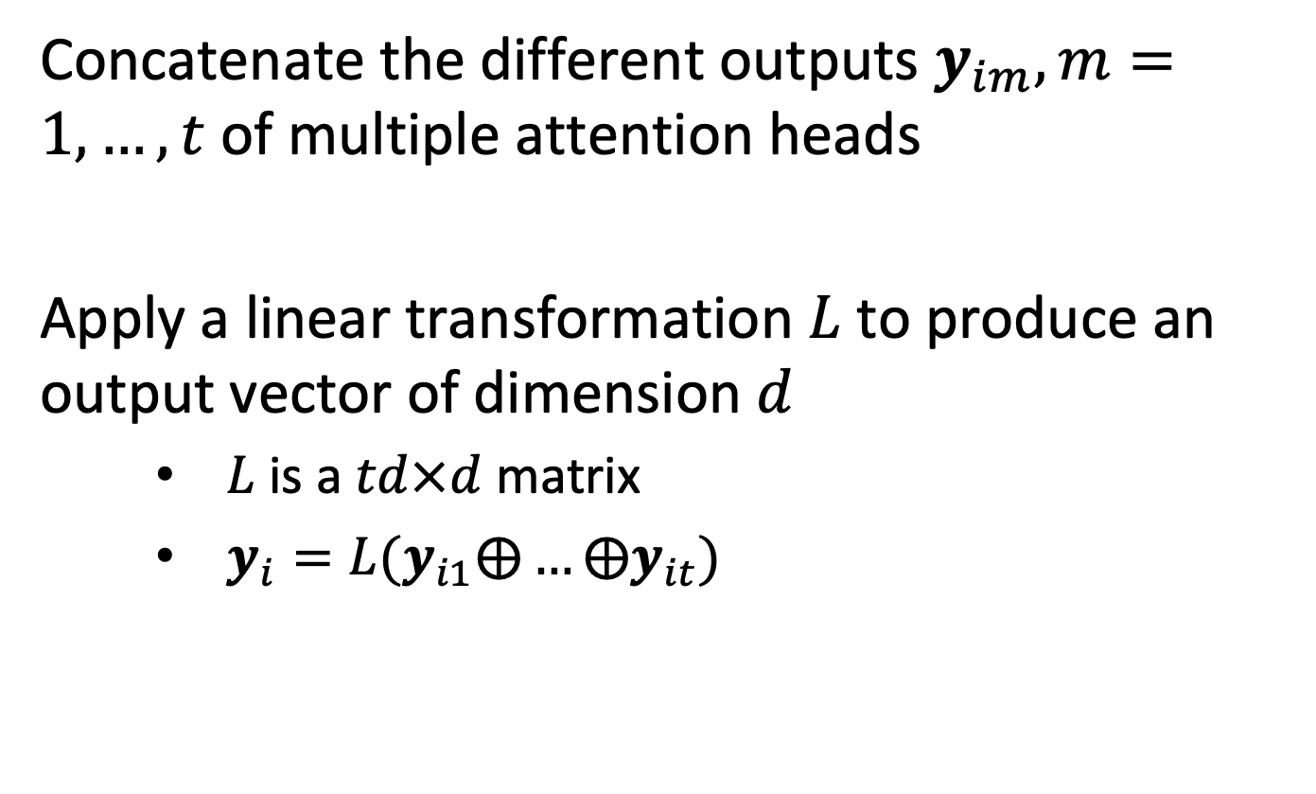
Combining Multi-head Attention Outputs
Concatenate the different outputs $y_{im}, m=1,…,t$ of multiple attention heads
Apply a linear transformation $L$to produce an output vector of dimension $d$
$L$ is a $td×d$ matrix
$y_{i}=L(y_{i1}⨁…{⨁y}_{it})$
Notes:
When using multi-head attention, multiple output vectors are produced. These are combined at the output, by applying a linear transformation that reduces the dimension of the concatenated output vectors, with is t*d, back to the standard embedding dimension d. The $⨁$ symbol denotes concatenation of vectors.

Slide 37
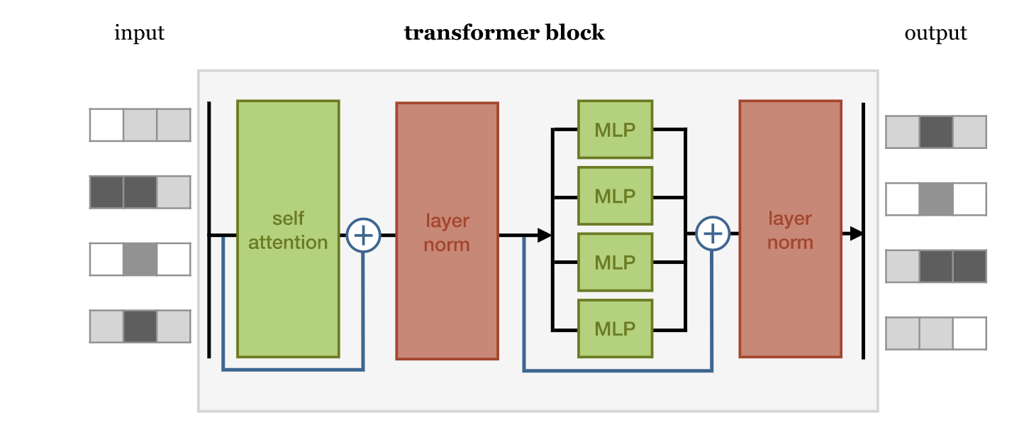
Transformers
Transformers use the self-attention mechanism as building block
Notes:
Using a multi-head attention mechanism allows now to establish what is called a transformer block. A transformer block takes the input vectors, applies the multi-head attention, and then performs further processing of the outputs. The additional processing steps are layer normalization and applying multi-layer perceptrons, a basic type of neural networks. We explain these steps next.

Slide 38
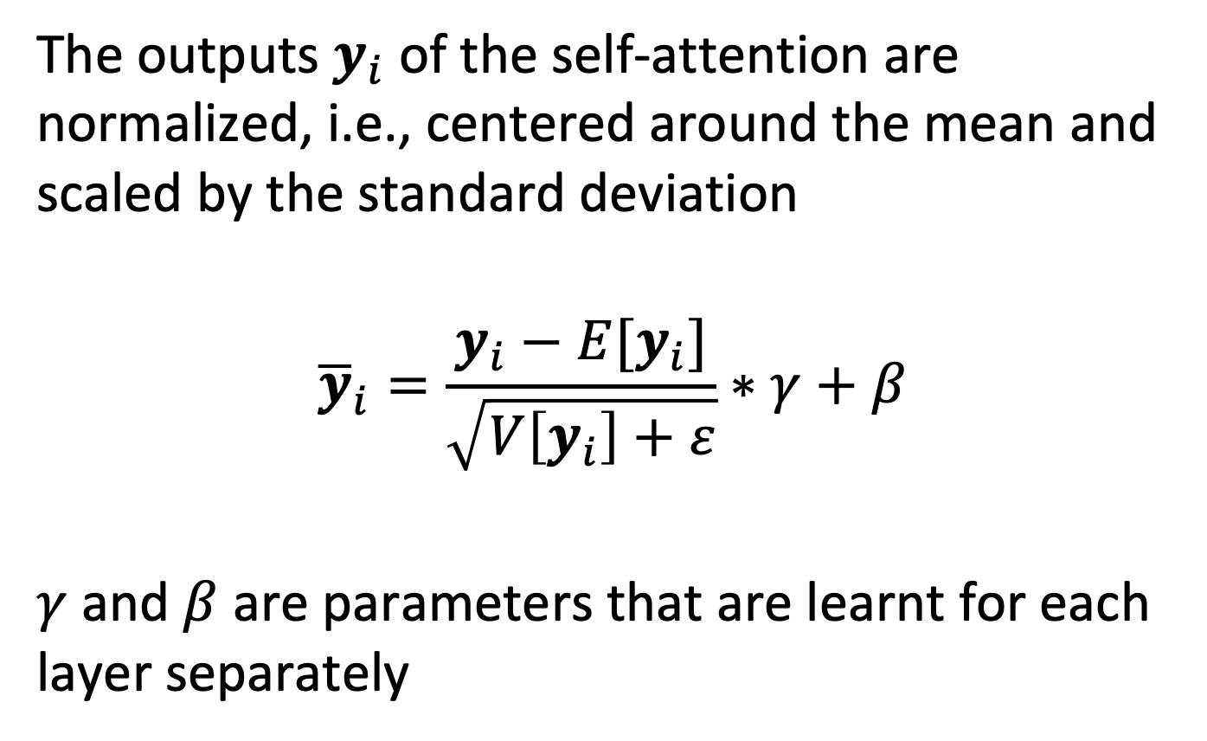
Layer Normalization
The outputs $y_{i}$ of the self-attention are normalized, i.e., centered around the mean and scaled by the standard deviation
$${\overline{y}}_{i}=\frac{y_{i}−E[y_{i}]}{\sqrt{V\left[y_{i}\right]+ε}}∗γ+β$$
$γ$ and $β$ are parameters that are learnt for each layer separately
Notes:
Normalization addresses the problem called internal covariate shift. Internal covariate shift refers to the change of distribution of values occurring during training of a neural network, going from one layer to the next. As the network learns and the weights are updated, the distribution of outputs of a specific layer in the network changes. This forces the higher layers to adapt to the drift occurring in lower layers, which slows down learning. Normalizing the inputs to the neural networks, eliminates this problem.
The gamma/beta values used for normalization are learnt for different layers separately but are the same for each layer.

Slide 39
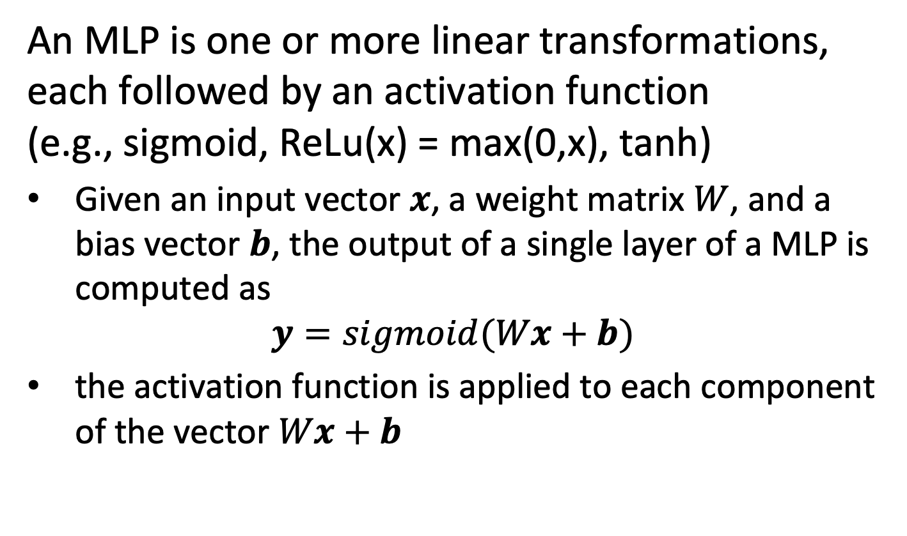
MLP – Multilayer Perceptron
An MLP is one or more linear transformations, each followed by an activation function (e.g., sigmoid, ReLu(x) = max(0,x), tanh)
Given an input vector $x$, a weight matrix $W$, and a bias vector $b$, the output of a single layer of a MLP is computed as
$$y=sigmoid(Wx+b)$$
the activation function is applied to each component of the vector $Wx+b$
Notes:
MLPs are a simple form of neural networks. They apply first a linear transformation to the input vectors, using a weight matrix W and adding a bias vector b. To the components of the output vector an activation function is applied, to introduce non-linearity. In the original neural network models this function was a sigmoid or tanh function. In current models and standard transformer models it is the Relu function which has better numerical behavior. The Relu function is defined as relu(x) = max(0,x). The MLP is also often called Feed Forward Network (FFN).

Slide 40
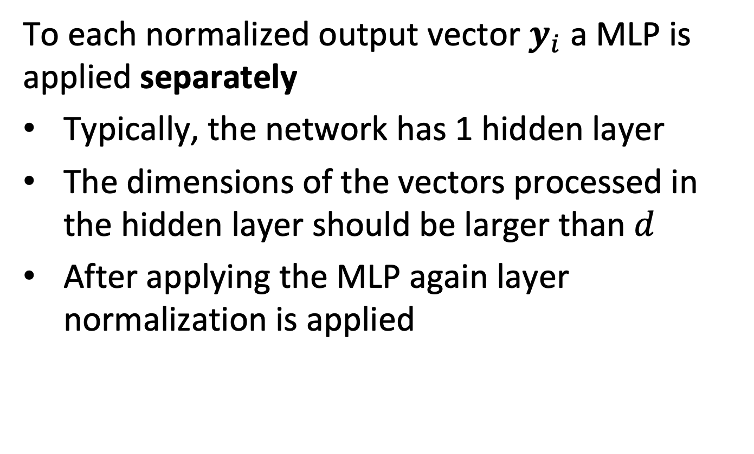
MLP in Transformer Networks
To each normalized output vector $y_{i}$ a MLP is applied separately
Typically, the network has 1 hidden layer
The dimensions of the vectors processed in the hidden layer should be larger than $d$
After applying the MLP again layer normalization is applied
Notes:
To each normalized output vector $y_{i}$ an MLP is applied separately. The MLPs applied to each position have the same parameters. They consist of two linear transformations with an activation in between. Therefore, they have one hidden layer.
While the linear transformations are the same across different positions, they use different parameters from layer to layer. The dimensions of the vectors processed in the MLP, i.e., at the hidden layer, should be larger than d.
Multi-Head Attention (MHA) module and the Feed Forward Network (FFN) module play different roles in the Transformer architecture: The MHA allows the model to jointly attend to information from different subspaces, while the latter increases the non-linearity of the model. In original BERT, the ratio of the number of parameter between the MHA and FFN is always 1:2. To keep that ratio, the inner-layer in the MLP has dimensionality dx4.

Slide 41
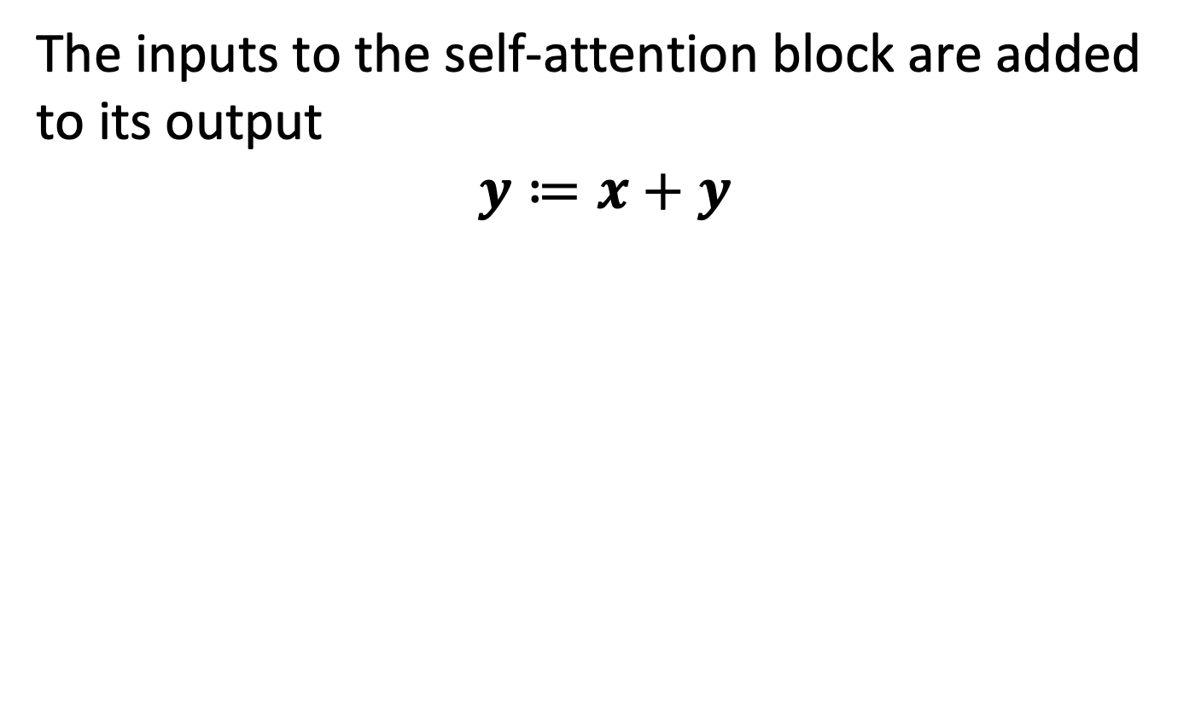
Residual Connections
The inputs to the self-attention block are added to its output
$$y≔x+y$$
Residual connections
Notes:
The inputs to the self-attention block are added to its output through so-called residual connections. Similarly, also for the MLPs.
Residual connections (also called skip connections) are used to allow gradients during backpropagation to flow through a network directly, without passing through non-linear activation functions. Non-linear activation functions, by nature of being non-linear, cause the gradients to explode or vanish (depending on the weights). This results in the problem of vanishing gradients which make it more difficult to learn from the feedback obtained through backpropagation.

Slide 42
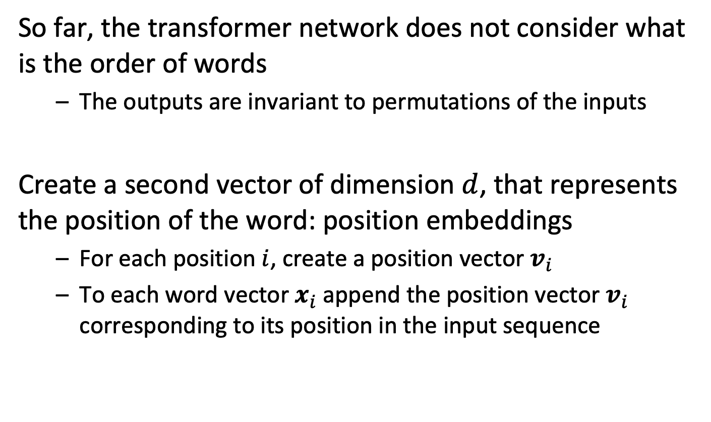
Position Embedding
So far, the transformer network does not consider what is the order of words
The outputs are invariant to permutations of the inputs
Create a second vector of dimension $d$, that represents the position of the word: position embeddings
For each position $i$, create a position vector $v_{i}$
To each word vector $x_{i}$append the position vector $v_{i}$ corresponding to its position in the input sequence
Notes:
The way the transformer network is defined so far is insensitive to the order of the inputs. In other words, any permutation of the inputs would generate the same relations, which is naturally not how language works. Therefore, in addition the position of words in a sentence needs to be provided as input to the transformer network. The way this is achieved is by learning a position vector, which is the representation of an input position. Each word vector is concatenated with the position vector corresponding to the word’s position within the sentence.

Slide 43
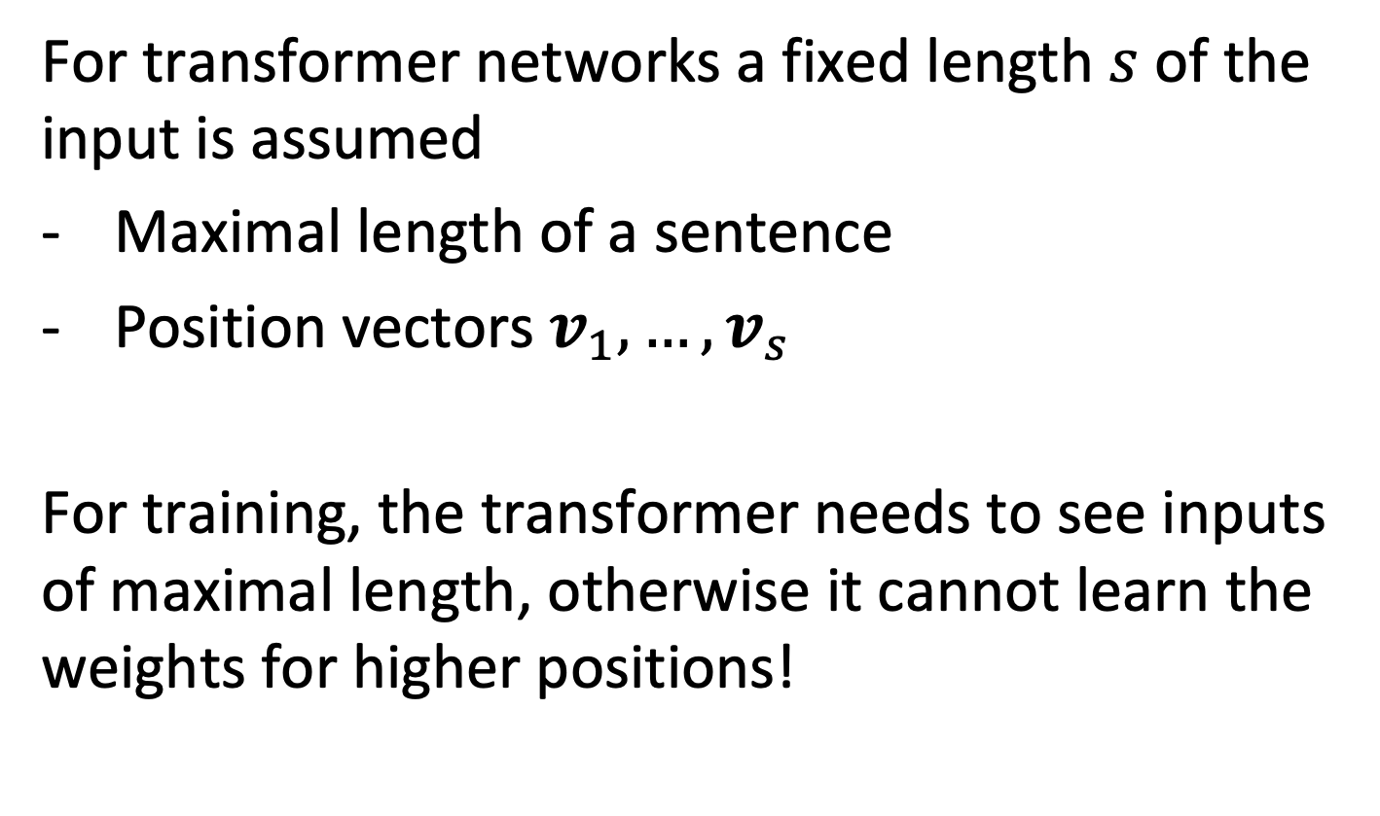
Input Length
For transformer networks a fixed length $s$ of the input is assumed
Maximal length of a sentence
Position vectors $v_{1},…,v_{s}$
For training, the transformer needs to see inputs of maximal length, otherwise it cannot learn the weights for higher positions!
Notes:
In order to learn position vectors, the length of the sequences (sentences) needs to be fixed, or in other words a maximal sequence length needs to be specified. For learning the parameters this requires that the training data needs to have sequences that have this maximal length, otherwise the position vectors or the higher positions cannot be learnt.

Slide 44
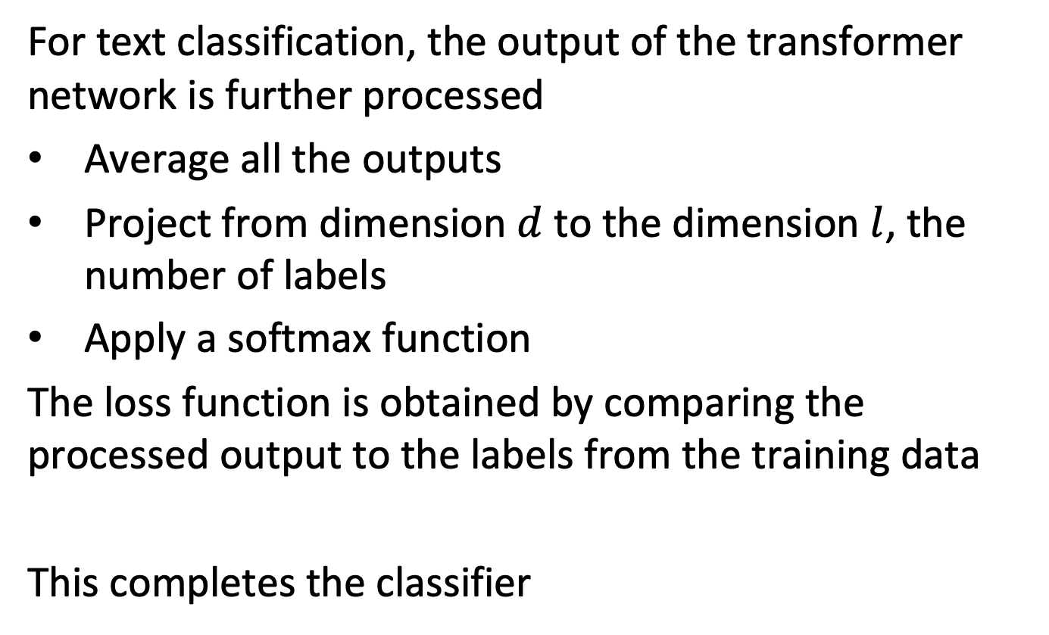
Classification Layer
For text classification, the output of the transformer network is further processed
Average all the outputs
Project from dimension $d$ to the dimension $l$, the number of labels
Apply a softmax function
The loss function is obtained by comparing the processed output to the labels from the training data
This completes the classifier
Notes:
When using a transformer network for text classification, the output vectors are used to produce a prediction for the classification label. In order to do this, a standard approach is to average the output vectors, project them using a linear mapping the the dimension of the label space and apply a softmax function to obtain values that can be interpreted as probabilities.
The predicted values are in the training phase compared to the labels from the training data, and a loss function is calculated from the difference. This is exactly same approach we have taken with our first simple text classifier using a self-attention mechanism.
Using the loss function the parameters can then be learnt using backpropagation. The backpropagation is implemented in frameworks such as pytorch that allows to automatically derive the gradients for the complex function defined by the transformer network.

Slide 45
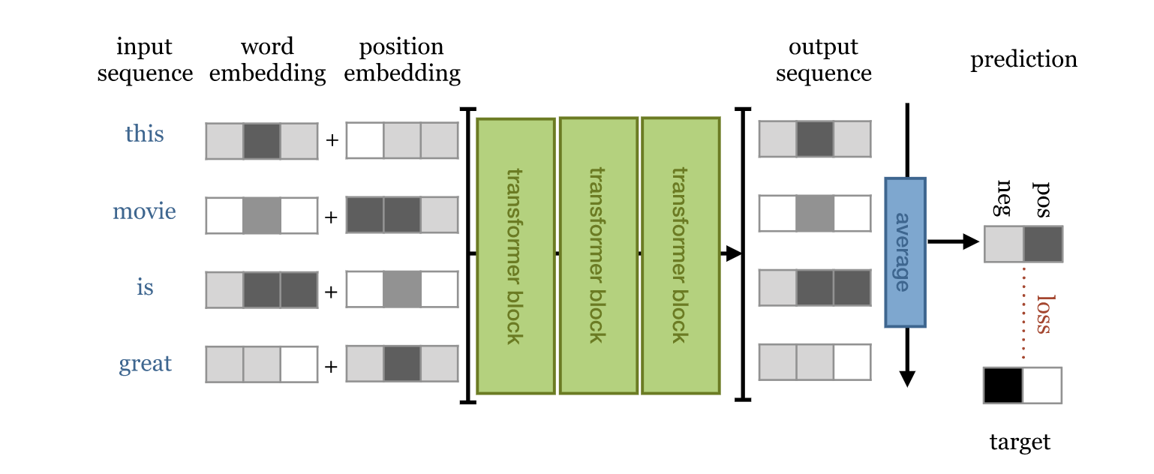
Putting it all together
The transformer blocks are combined to perform a task, e.g., classification
Notes:
This diagram illustrates the overall architecture of a typical transformer network. We see that multiple transformer blocks are applied in sequence (each of which contains a multi-head self-attention mechanism).

Slide 46
Visualization of Layers and Heads
Notes:
From:
https://towardsdatascience.com/deconstructing-bert-part-2-visualizing-the-inner-workings-of-attention-60a16d86b5c1

Slide 47
Finetuning
In general transformer networks are not trained from scratch, but built on top of pretrained networks (transfer learning)
For a given task the network or part of it can be retrained
Notes:
In practice, given the very large number of parameters in transformer networks, they are usually not trained from scratch, in particular, when using them to build a document classifier. Instead, pretrained networks are used. For example, Huggingface is a platforms that provides a large number of pretrained models. The pretrained network is completed with a classification layer and retrained using the training data for classification. Retraining a network is called finetuning.
This approach has the advantage that general properties of natural language are already encoded in the network parameters and need not to be learnt from scratch every time. This training is in general hugely expensive.
There exist different variants of how fine-tuning is performed, depending whether all are only a part of the parameters of the pre-trained transformer network are modified during retraining.

Slide 48
Final Remarks
For the sake of time, we have been ignoring a number of aspects
Some standard ways of training (e.g., masking)
Use of special [CLS] token for sentence representation
Application to standard NLP tasks (e.g, translation)
Details of backpropagation in training (e.g., done by pytorch)
Detailed motivation of technical choices in the architecture based on empirics in NN, e.g., that help to speed up convergence
The use of Byte-Pair-Encoding tokenizers
Different types of loss functions
Notes:
This introduction to transformer network aimed at highlighting the basic principles underlying their architecture. Many details related to their training, application, and the implementation of deep neural networks have not been discussed, as they are beyond the scope of this lecture.

Slide 49
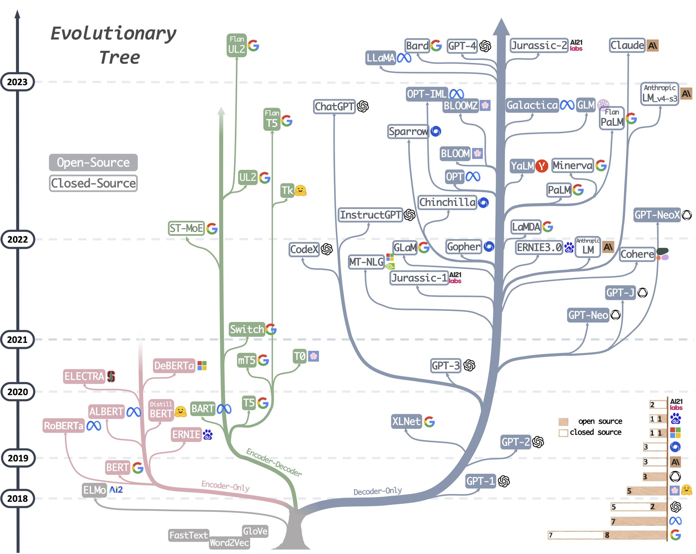
History of Transformer Models

Slide 50
Document Classification: Summary
Widely studied problem with many applications
Spam filtering, Sentiment Analysis, Document Search
Increasing interest
Powerful methods using very large corpuses
Information filtering on the Internet
Significant improvements using transformer networks
From classifying using bag of words to word sequences
Better contextual understanding of language
Notes:
Document classification is an area of high interest, both because it is required in a growing number of application domains and because at the same time the classification methods are becoming increasingly powerful due to the availability of very large document corpuses, the growing computational power available and the recent developments around transformer networks.

Slide 51
References
Kowsari, Kamran, Kiana Jafari Meimandi, Mojtaba Heidarysafa, Sanjana Mendu, Laura Barnes, and Donald Brown. "Text classification algorithms: A survey." Information 10, no. 4 (2019): 150.
The introduction on transformers is based on this tutorial
http://peterbloem.nl/blog/transformers
Visualization tools can be found here
https://towardsdatascience.com/deconstructing-bert-part-2-visualizing-the-inner-workings-of-attention-60a16d86b5c1

